Slide 1


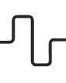


Milestone 4 – Deployment, Query Answering & Domain Linking
Milestone 4 concludes our semantic knowledge graph project, transitioning it into a dynamic, interactive system. This phase focuses on making interconnected data accessible and actionable, enabling intuitive information engagement and meaningful insights.
Interactive Web Deployment
Natural Language Query Capabilities
Domain-Based Entity Categorization
Advanced Graph Analytics
Launching a user-friendly web interface for seamless navigation and visualization of the knowledge graph.
Enabling NLP-based queries to let users ask complex questions and receive precise answers directly from the graph.
Enhancing the graph by linking entities to specific domains for richer search and analysis.
Integrating tools to analyze relationships and patterns, uncovering hidden insights.

Slide 2
Project Overview: Building on Milestone 3
Milestone 4 significantly advances the work from Milestone 3, which established the foundational semantic knowledge graph pipeline. This previous phase focused on transforming raw data into a structured, interconnected graph.
01
02
Data Collection & Preprocessing
Named Entity Recognition (NER)
Initial phase involving the gathering and cleaning of raw textual data to ensure quality and relevance for subsequent processing.
Identification and classification of key entities within the preprocessed text, such as persons, organisations, and locations.
03
04
Relation Extraction
Semantic Graph Construction & Visualization
Discovery and categorisation of semantic relationships between the identified entities, forming the core of the knowledge graph.
Building the knowledge graph from extracted entities and relations, followed by its visual representation for intuitive understanding.

Slide 3
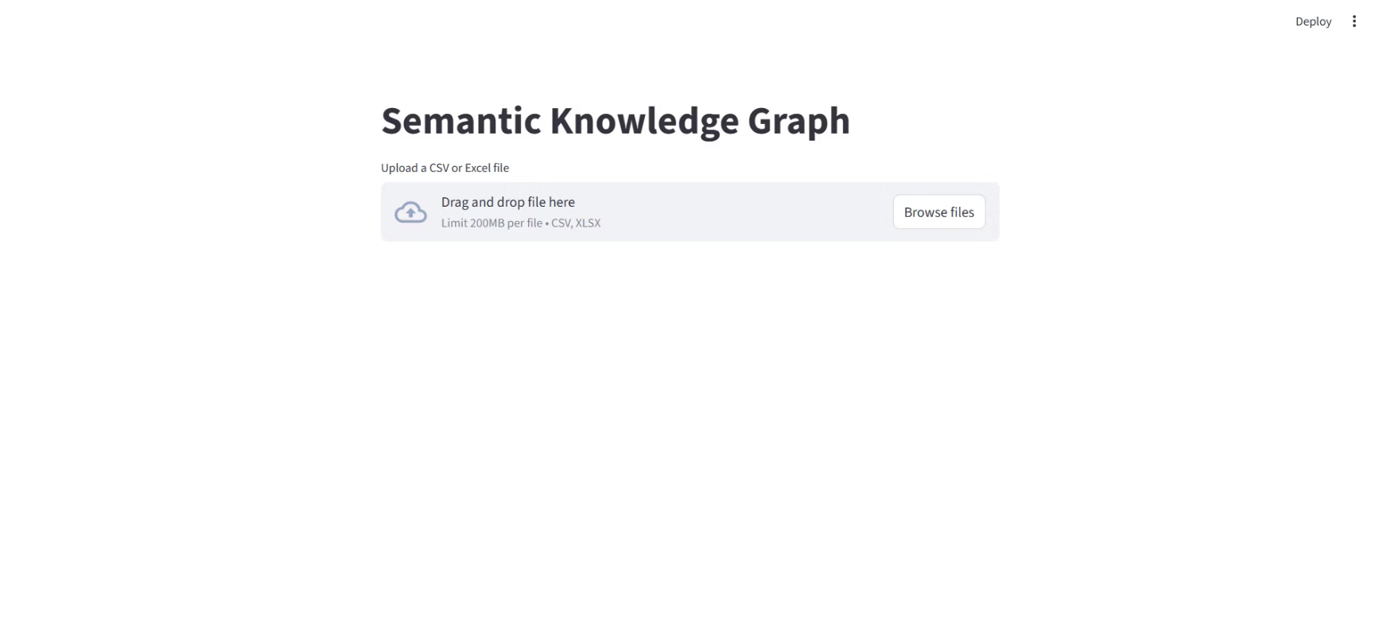
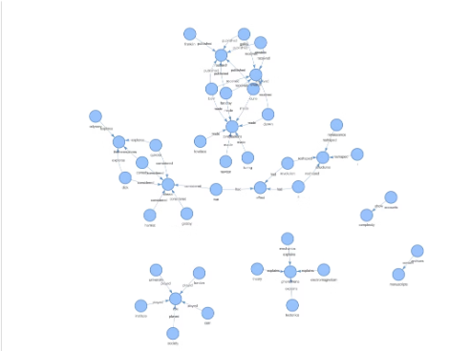
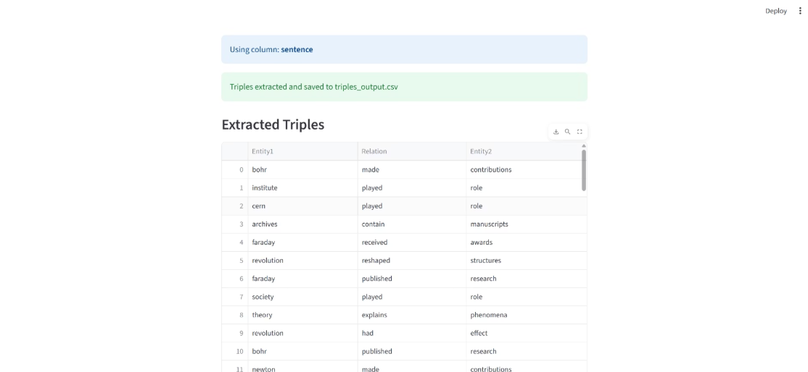
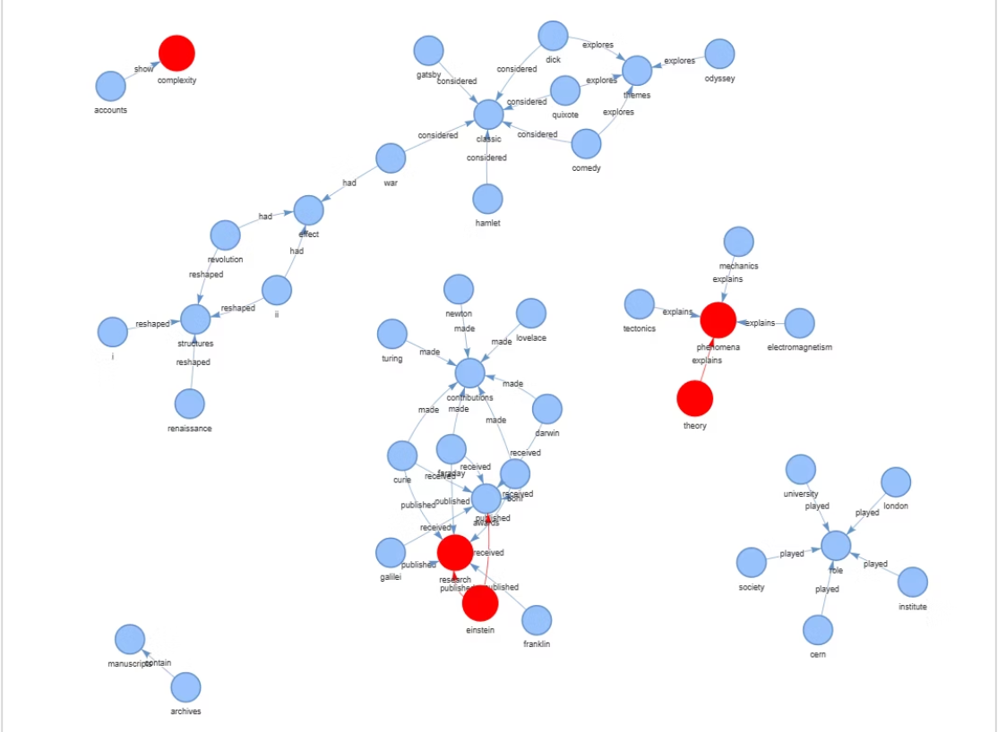
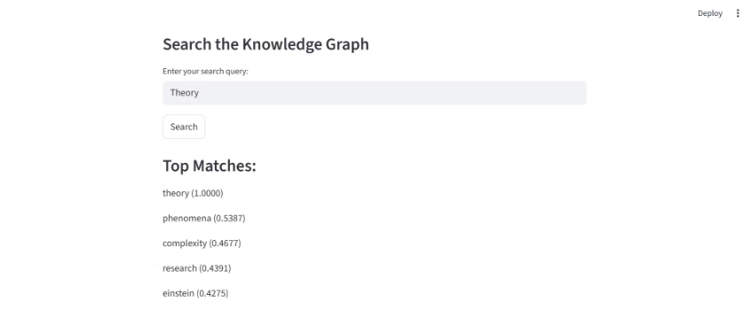
Project Output Overview
A unified view of our deployed semantic knowledge graph system, showcasing data upload, extraction, visualization,
and query answering features.
Data Upload Interface
Graph Visualization
Extracted Triples Table
Search Interface
Highlighted Query Results

Slide 4
Objectives of Milestone 4
Milestone 4 focuses on transforming the semantic knowledge graph into an interactive and analytical tool, enhancing its utility and accessibility.
1
2
Deploy Interactive Application
Enable Query Answering
To create a user-friendly, interactive application for seamless interaction with the knowledge graph.
To allow users to pose natural language queries and receive relevant insights from the graph.
3
4
Link Entities to Domains
Analyse Graph Structure
To enrich the graph by associating entities with broader subject domains, providing deeper context.
To perform structural analysis, including centrality and community detection, to uncover hidden patterns and importance.

Slide 5
Milestone 4: Key Focus Areas
These three focus areas represent the core deliverables of Milestone 4, aimed at transforming our semantic knowledge graph into a more powerful, accessible, and intelligent analytical tool.
Centrality & Community Detection
Query Answering & Domain Linking
Deployment
Perform advanced graph analysis using algorithms like PageRank and betweenness centrality to identify central nodes and detect communities, revealing hidden structures and influential entities within the knowledge graph.
Implement NLP-based query answering, leveraging Sentence Transformers for semantic similarity, and categorize entities by domains (e.g., Science, History) to enrich search results and provide deeper contextual understanding.
Deploy the interactive application built with the Streamlit framework, enabling users to seamlessly upload data, visualize graphs, query entities, and analyze relationships through a user-friendly interface.

Slide 6
Understanding Centrality & Community Detection
This is a crucial component of graph analysis that helps understand structure and importance of elements in the semantic knowledge graph.
Centrality Analysis
Community Detection
Centrality measures identify the most important or influential nodes (entities) within the graph:
This identifies clusters of closely related entities:
Degree Centrality: Counts direct connections. High degree = highly connected entity. Example: "Einstein" might connect to many physics concepts, theories, and scientists.
Purpose: Groups entities more connected to each other than to the rest of the graph. Reveals thematic clusters and subject areas.
Betweenness Centrality: Measures how often a node lies on shortest paths between other nodes. High betweenness = acts as a "bridge". Example: "Energy" might connect physics, chemistry, and biology domains.
Algorithms: Louvain Method optimizes modularity to find dense communities. Modularity Optimization maximizes within-group connections, minimizes between-group connections.
Benefits: Knowledge organization, pattern discovery, search enhancement, and improved visualization with color-coded communities.
PageRank/Eigenvector Centrality: Considers quality of connections, not just quantity. Connected to important nodes = higher centrality. Example: "Newton" connected to "gravity," "calculus," and "physics" gets high centrality.

Slide 7
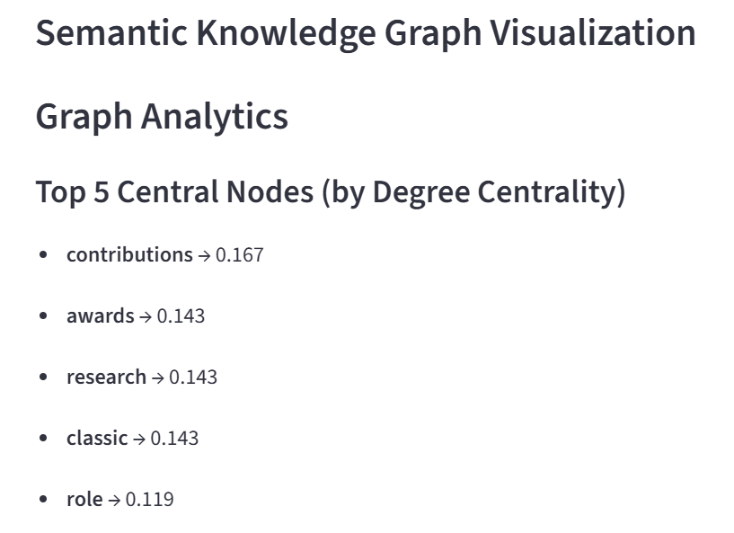
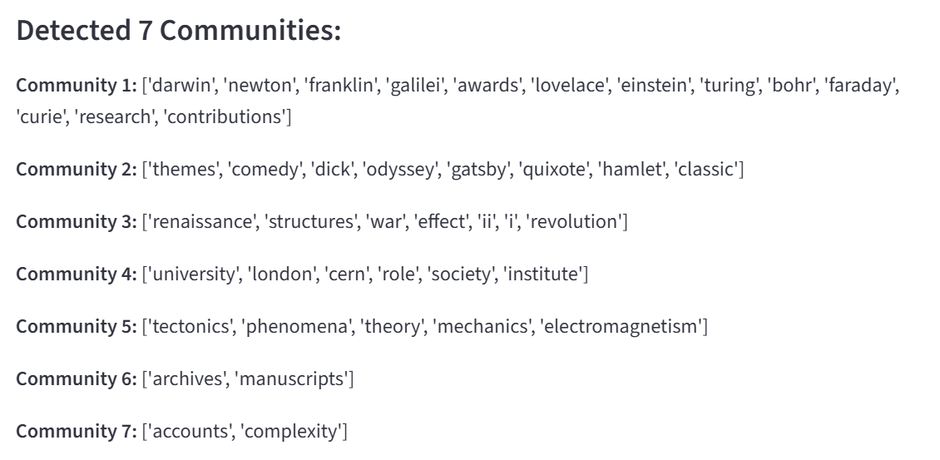
Centrality & Community Detection

Slide 8
Query Answering: Natural Language Interaction
The system now supports natural language query answering, allowing users to interact with the knowledge graph using intuitive questions rather than complex technical commands. This is achieved through advanced semantic matching techniques.
Natural Language Input: Users can type questions or phrases directly into a search bar.
Semantic Matching: Queries are processed using Sentence Transformers, specifically the MiniLM model, to understand the underlying meaning and intent.
Relevant Retrieval: The system intelligently retrieves entities and relations from the knowledge graph that semantically align with the user's query.
Visual Highlighting: Retrieved information is highlighted within the graph visualization, making it easy for users to identify and understand the answers.
This functionality significantly enhances the usability of the knowledge graph, transforming it into a powerful tool for information retrieval and exploration.

Slide 9
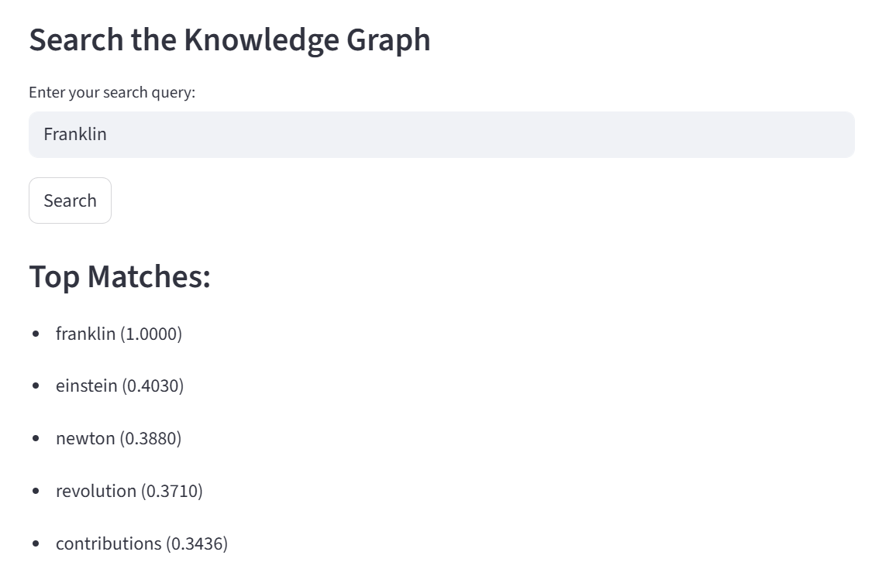
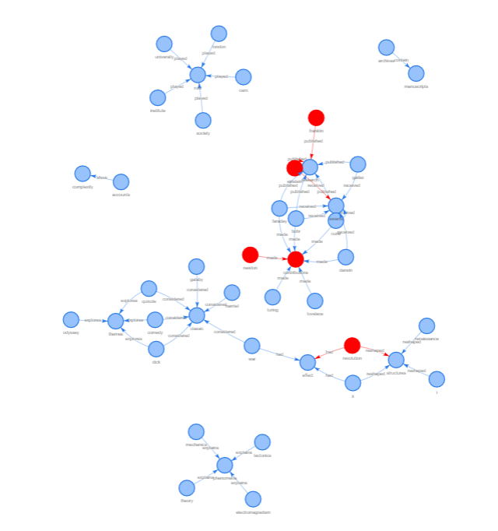
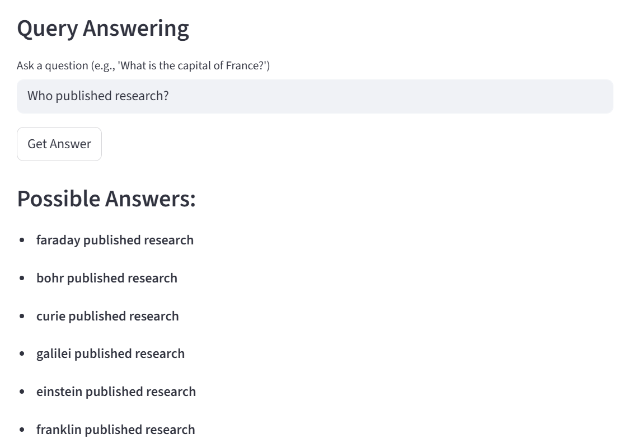
Query Answering: Natural Language Interaction

Slide 10
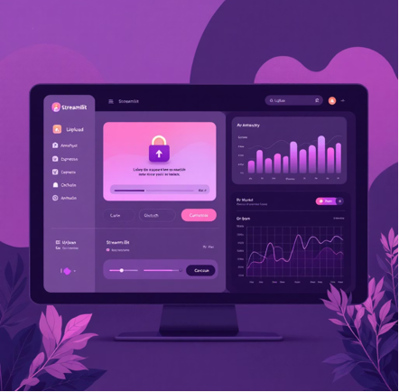
Deployment: Interactive Streamlit Application
The semantic knowledge graph system has been deployed as an interactive web application using Streamlit. This deployment provides a user-friendly interface for interacting with the complex underlying data structures.
File Upload: Users can upload their own documents for analysis.
Entity & Relation Extraction: Automated identification of key entities and their relationships from uploaded text.
Dynamic Visualization: Real-time rendering of the knowledge graph, allowing users to explore connections visually.
Search Functionality: Integrated search capabilities to quickly locate specific entities or relations within the graph.
This interactive platform makes the powerful capabilities of the semantic knowledge graph accessible to a broader audience, facilitating data exploration and insight generation.

Slide 11




Domain Linking: Enriching Context
To provide richer context and facilitate more nuanced analysis, entities within the knowledge graph are now linked to relevant subject domains. This process categorises entities, making the graph more organised and insightful.
Science
History
Linking scientific terms, theories, and discoveries to the 'Science' domain.
Connecting historical figures, events, and periods to the 'History' domain.
Literature
Geography
Associating authors, works, and literary concepts with the 'Literature' domain.
Mapping locations, landmarks, and geographical features to the 'Geography' domain.
This domain linking enriches the graph with valuable metadata, enabling users to filter, explore, and analyse information based on specific areas of knowledge. For example, a query about "Newton" could reveal his contributions in both "Science" and "History".

Slide 12
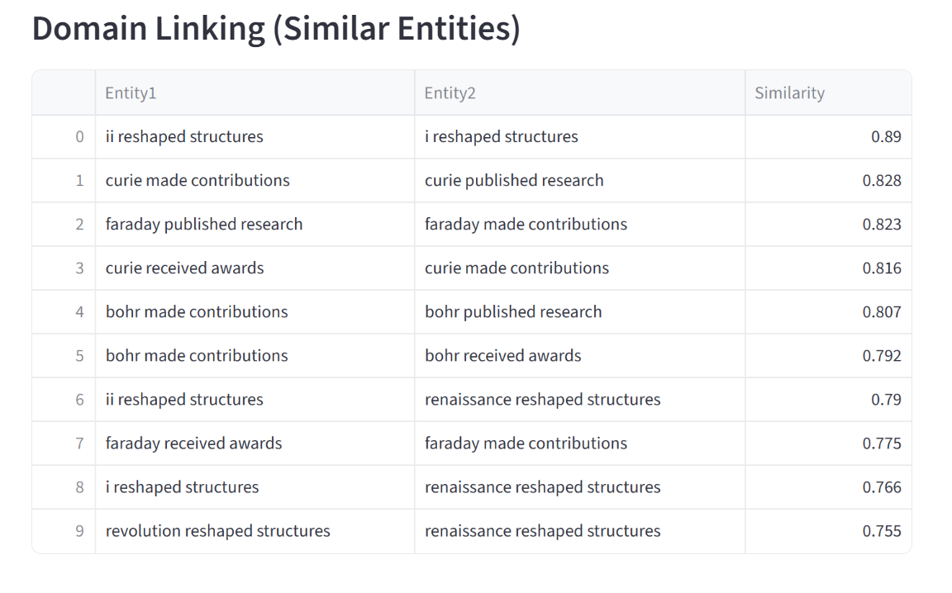
Domain Linking: Enriching Context

Slide 13
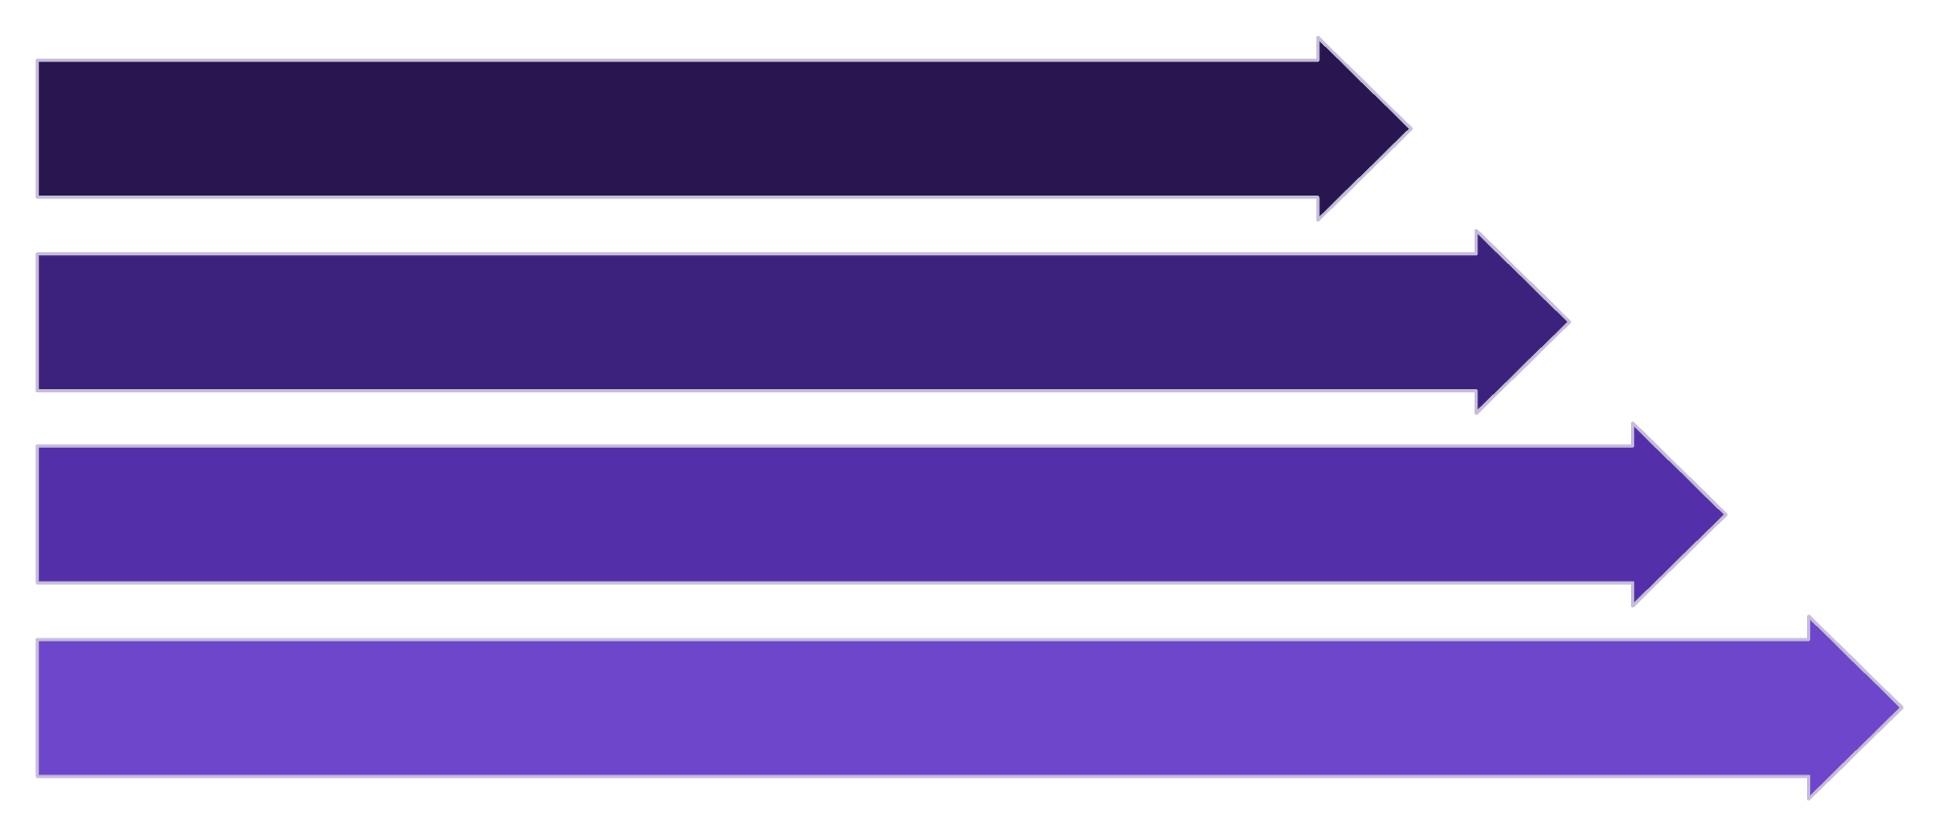
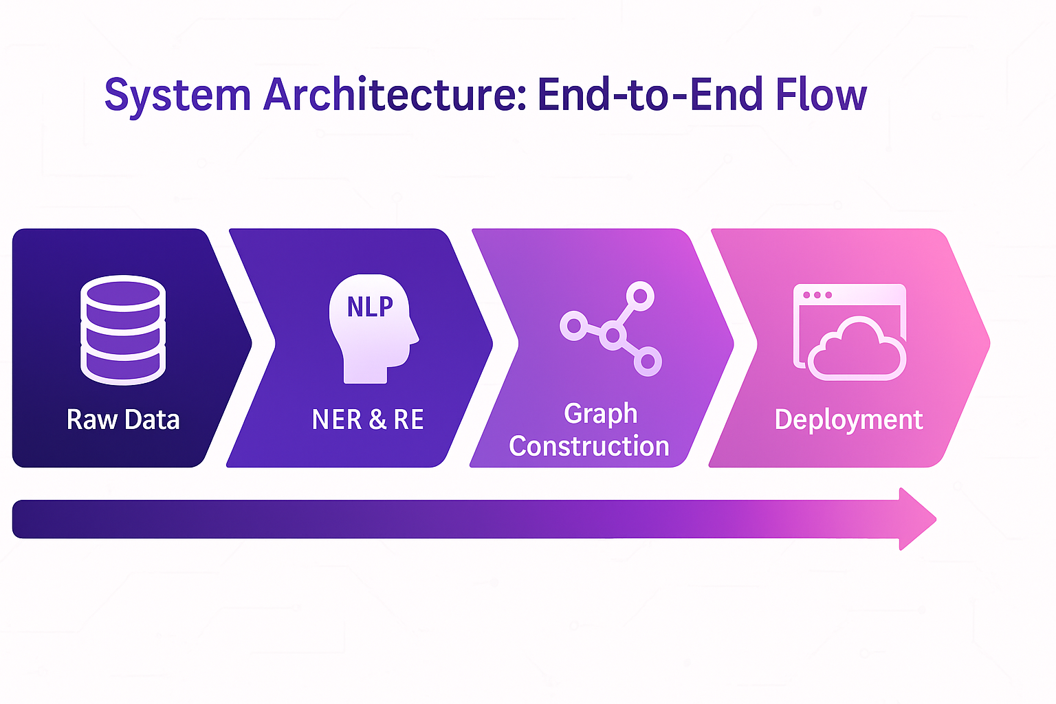
System Architecture: End-to-End Flow
The complete system architecture integrates all components from raw data ingestion to advanced graph analysis, forming a cohesive and powerful knowledge management solution.
Raw Data
NER & RE
Graph Construction
Deployment
This streamlined architecture ensures efficient processing and interaction, enabling users to derive maximum value from the semantic knowledge graph.

Slide 14
THANK YOU
Team Members
Shivam Kanse
SaiTejaswi
Poobesh Raj
Jahnavi Lakshmi

